Slide 1
Composite materials Wessam Al Azzawi
Lecture 4: Incorporation of fibers into matrix
Processes for incorporating fibers into a polymer matrix can be divided into two categories.
In one category, fibers and matrix are processed directly into the finished product or structure. Examples of such processes are filament winding and pultrusion.
In the second category, fibers are incorporated into the matrix to prepare ready-to-mold sheets that can be stored and later processed to form laminated structures by autoclave molding or compression molding.
In this section, we briefly describe the processes used in preparing these ready-to-mold sheets. Knowledge of these processes will be helpful in understanding the performance of various composite laminates.

Slide 2
Composite materials Wessam Al Azzawi
Lecture 4: Incorporation of fibers into matrix
Ready- to-mold fiber-reinforced polymer sheets are available in two basic forms, prepregs and sheet-molding compounds.
PREPREGS
These are thin sheets of fibers impregnated with predetermined amounts of uniformly distributed polymer matrix. Fibers may be in the form of continuous rovings, mat, or woven fabric. Epoxy is the primary matrix material in prepreg sheets, although other thermoset and thermoplastic polymers have also been used. The width of prepreg sheets may vary from less than 25 mm (1 in.) to over 457 mm (18 in.). Sheets wider than 457 mm are called broadgoods. The thickness of a ply cured from prepreg sheets is normally in the range of 0.13–0.25 mm (0.005–0.01 in.). Resin content in commercially available prepregs is between 30% and 45% by weight. Unidirectional fiber-reinforced epoxy prepregs are manufactured by pulling a row of uniformly spaced (collimated) fibers through a resin bath containing catalyzed epoxy resin dissolved in an appropriate solvent (Fig.1). The solvent is used to control the viscosity of the liquid resin. Fibers preimpregnated with liquid resin are then passed through a chamber in which heat is applied in a controlled manner to advance the curing reaction to the B-stage. At the end of B-staging, the prepreg sheet is backed up with a release film or waxed paper and wound around a take-up roll. The backup material is separated from the prepreg sheet just before it is placed in the mold to manufacture the composite part. The normal shelf life (storage time before molding) for epoxy prepregs is 6–8 days at 23ºC; however, it can be prolonged up to 6 months or more if stored at -18ºC.

Slide 3
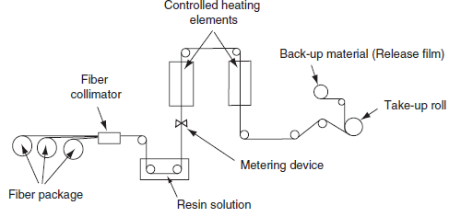
Fig.1

Slide 4
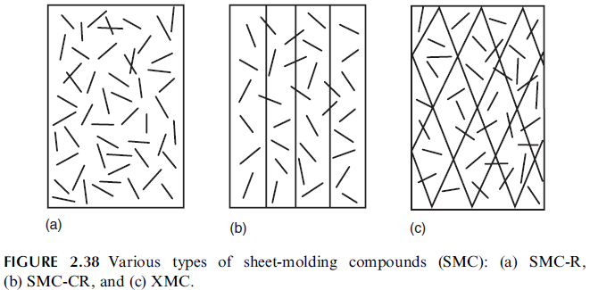
Composite materials Wessam Al Azzawi
Lecture 4: Incorporation of fibers into matrix
Sheet-molding compounds
Sheet-molding compounds (SMC) are thin sheets of fibers precompounded with a thermoset resin and are used primarily in compression molding process. Common thermoset resins for SMC sheets are polyesters and vinyl esters. The longer cure time for epoxies has limited their use in SMC.
The various types of sheet-molding compounds in current use Figure are as follows:

Slide 5
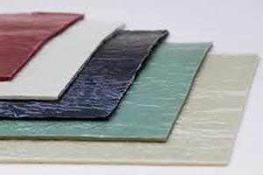

Slide 6
Composite materials Wessam Al Azzawi
Lecture 4: Incorporation of fibers into matrix
SMC-R, containing randomly oriented discontinuous fibers. The nominal fiber content (by weight percent ) is usually indicated by two-dig after the letter R. For example, the nominal fiber content in SMC-R30 is 30% by weight.
SMC-CR, containing a layer of unidirectional continuous fibers on top of a layer of randomly oriented discontinuous fibers. The nominal fiber contents are usually indicated by two-dig after the letters C and R. For example, the nominal fiber contents in SMC-C40 R30 are 40% by weight of unidirectional continuous fibers and 30% by weight of randomly oriented discontinuous fibers.
XMC (trademark of PPG Industries), containing continuous fibers arranged in an X pattern, where the angle between the inter laced fibers is between 58 and 78. Additionally, it may also contain randomly oriented discontinuous fibers interspersed with the continuous fibers.

Slide 7
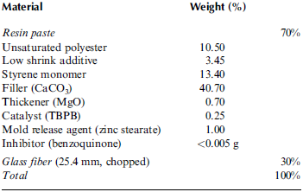
Composite materials Wessam Al Azzawi
Lecture 4: Incorporation of fibers into matrix
A typical formulation for sheet-molding compound SM C-R30 is presented in Table.1. In this formulation, the unsaturated polyester and styrene are polymerized together to form the polyester matrix.
The role of the low shrink additive, which is a thermoplastic polymer powder, is to reduce the polymerization shrinkage.
The function of the catalyst is to initiate the polymerization reaction, but only at an elevated temperature.
The function of the inhibitor is to prevent premature curing (gelation) of the resin that may start by the action of the catalyst while the ingredients are blended together.
The mold release agent acts as an internal lubricant, and helps in releasing the molded part from the die.
Fillers assist in reducing shrinkage of the molded part, promote better fiber distribution during molding, and reduce the overall cost of the compound.
Table.1

Slide 8
Composite materials Wessam Al Azzawi
Lecture 4: Incorporation of fibers into matrix
Typical filler–resin weight ratios are 1.5:1 for SMC- R30, 0.5: 1 for SMC-R50, and nearly 0:1 for SMC- R65.
The thickener is an important component in an SMC formulation since it increases the viscosity of the compound without permanently curing the resin and thereby makes it easier to handle an SMC sheet before molding.
At the end of the thickening reaction, the compound becomes dry, nontacky, and easy to cut and shape.
With the application of heat in the mold, the thickening reaction is reversed and the resin paste becomes sufficiently liquid-like to flow in the mold.
Common thickeners used in SMC formulations are oxides and hydroxides of magnesium and calcium, such as MgO, Mg(O H)₂, CaO, and Ca( OH) ₂

Slide 9
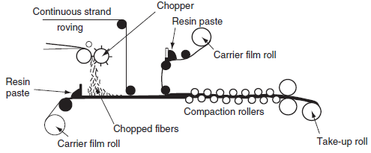
Composite materials Wessam Al Azzawi
Lecture 4: Incorporation of fibers into matrix
SMC-R and SMC-CR sheets are manufactured on a sheet-molding compound machine (Fig.2). The resin paste is prepared by mechanically blending the various components listed in Table.1. It is placed on two moving polyethylene carrier films behind the metering blades. The thickness of the resin paste on each carrier film is determined by the vertical adjustment of the metering blades. Continuous fibres are fed into the chopper, which is commonly set to provide 25.4 mm long discontinuous fibers. Chopped fibers are deposited randomly on the bottom resin paste. For SMC-CR sheets, parallel lines of continuous strand are fed on top of the chopped fiber layer. After covering the fibers with the top resin paste, the carrier films are pulled through a number of compact ion roll s to form a sheet that is then wound around a take-up roll.
SMC
SMC
Fig.2

Slide 10
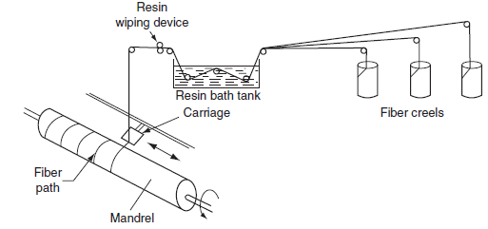
Composite materials Wessam Al Azzawi
Lecture 4: Incorporation of fibers into matrix
XMC sheets are manufactured by the filament winding process Fig.3 in which continuous strand are pulled through a tank of resin paste and wound under tension around a large rotating cylindrical drum. Chopped fibers, usually 25.4 mm long, are deposited on the continuous fiber layer during the time of winding. After the desired thickness is obtained, the built-up material is cut by a knife to form the XMC sheet. At the end of manufacturing, SMC sheets are allowed to ‘‘mature’’ (thicken or increase in viscosity) at about 30ºC for 1–7 days. The matured sheet can be either compression molded immediately or stored at -18ºC for future use.
Filament winding
Fig.3

Slide 11
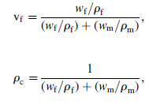
Composite materials Wessam Al Azzawi
Lecture 4: Incorporation of fibers into matrix
Fiber content, density, and void content
Theoretical calculations for strength, modulus, and other properties of a fiber reinforced
composite are based on the fiber volume fraction in the material. Experimentally, it is easier to determine the fiber weight fraction w_{f}, from which the fiber volume fraction v_{f} and composite density ρ_{c} can be calculated:

Slide 12
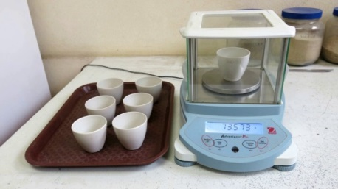
Composite materials Wessam Al Azzawi
Lecture 4: Incorporation of fibers into matrix
In terms of volume fractions, the composite density ρc can be written as
where v_{f} is the fiber volume fraction and v_{m} is the matrix volume fraction. Note that v_{m} is equal to (1-v_{f}).
The fiber weight fraction can be experimentally determined by either the ignition loss method (ASTM D2854) or the matrix digestion method (ASTM D3171).
The ignition loss method is used for PMC-containing fibers that do not lose weight at high temperatures, such as glass fibers. In this method, the cured resin is burned off from a small test sample at 5008C–6008C in a muffle furnace. Burn out test
In the matrix digestion method, the matrix (either polymeric or metallic) is dissolved away in a suitable liquid medium, such as concentrated nitric acid. In both cases, the fiber weight fraction is determined by comparing the weights of the test sample before and after the removal of the matrix

Slide 13
Composite materials Wessam Al Azzawi
Lecture 4: Incorporation of fibers into matrix
For unidirectional composites containing electrically conductive fibers (such as carbon) in a nonconductive matrix, the fiber volume fraction can be determined directly by comparing the electrical resistivity of the composite with that of fibers.
During the incorporation of fibers into the matrix or during the manufacturing of laminates, air or other volatiles may be trapped in the material. The trapped air or volatiles exist in the laminate as micro voids, which may significantly affect some of its mechanical properties. A high void content (over 2% by volume ) usually leads to lower fatigue resistance, greater susceptibility to water diffusion, and increased variation (scatter) in mechanical properties. The void content in a composite laminate can be estimated by comparing the theoretical density with its actual density:
Equ.2 and 3

Slide 14
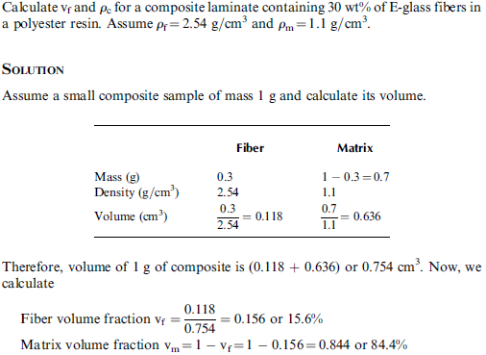
Composite materials Wessam Al Azzawi
Lecture 4: Incorporation of fibers into matrix
Example:

Slide 15
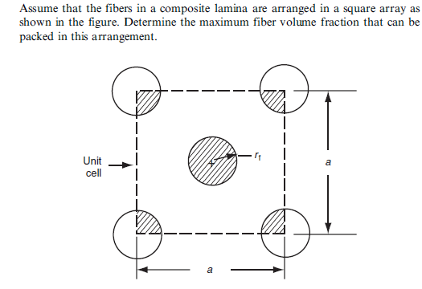
Composite materials Wessam Al Azzawi
Lecture 4: Incorporation of fibers into matrix
Example:

Slide 16
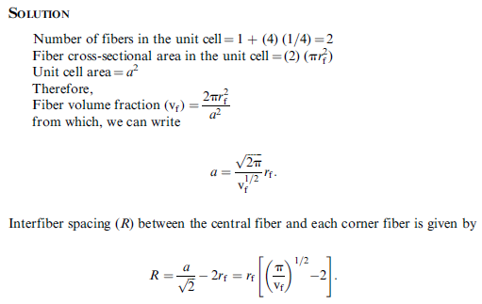
Composite materials Wessam Al Azzawi
Lecture 4: Incorporation of fibers into matrix

Slide 17
Composite materials Wessam Al Azzawi
Lecture 4: Incorporation of fibers into matrix
FIBER ARCHITECTURE
Fiber architecture is defined as the arrangement of fibers in a composite, which not only influences the properties of the composite, but also its processing.
The characteristics of fiber architecture that influence the mechanical properties include
Fiber continuity
Fiber orientation
Fiber crimping
Fiber interlocking
During processing, matrix flow through the fiber architecture determines:
The void content
Fiber wetting
Fiber distribution
Dry area and others in the final composite,
which in turn, affect the properties and performance.

Slide 18
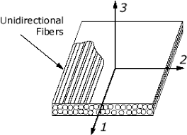
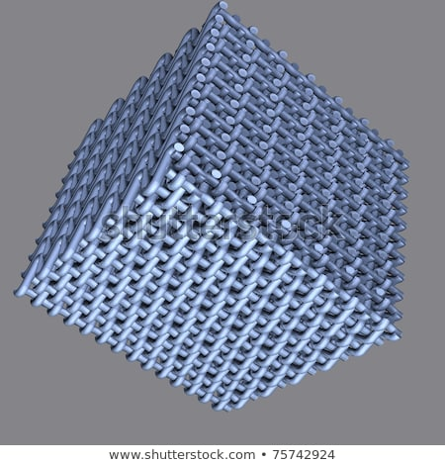
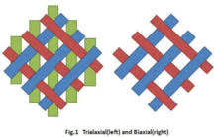
Composite materials Wessam Al Azzawi
Lecture 4: Incorporation of fibers into matrix
If continuous fibers are used, the fiber architecture can be one-dimensional, two-dimensional , or three- dimensional.
The one -dimensional architecture can be produced by the prepregging technique described earlier or by other manufacturing methods, such as pultrusion.
The two-and three-dimensional architectures are produced by textile manufacturing processes and are used with liquid composite molding processes, such as resin transfer molding, in which a liquid polymer is vacuumed or injected into the dry fiber preform containing two-or three dimensional fiber architecture.
Each fiber architecture type has its unique characteristic s, and if properly used, can provide an opportunity not only to tailor the structural performance of the composite, but also to produce a variety of structural shapes and forms.

